Slide 1
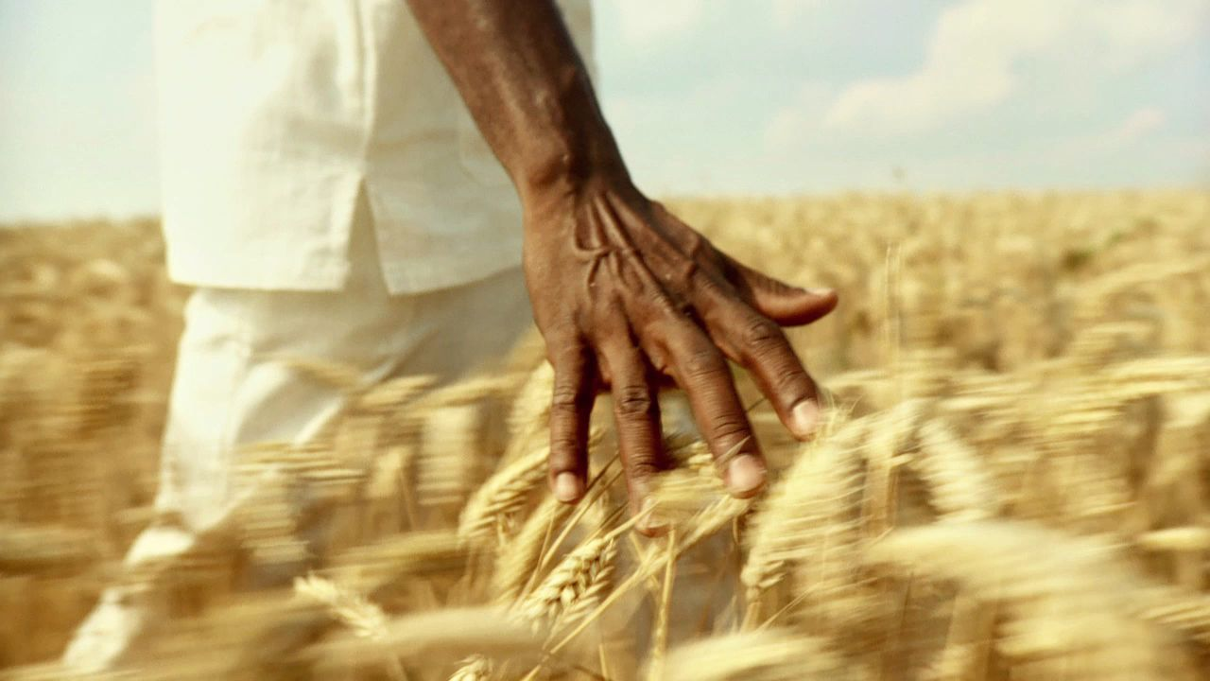
Exploring Relationship Between Indian Agriculture and Country Information
Team Members – Group 19
SAI RAM AMARANENI - 11711343
PRAHARSHA MUTYALA - 11712768
MURALI MANOBHIRAM PENUMUTCHU - 11719430
SATISH VELAGA - 11704025

Slide 2
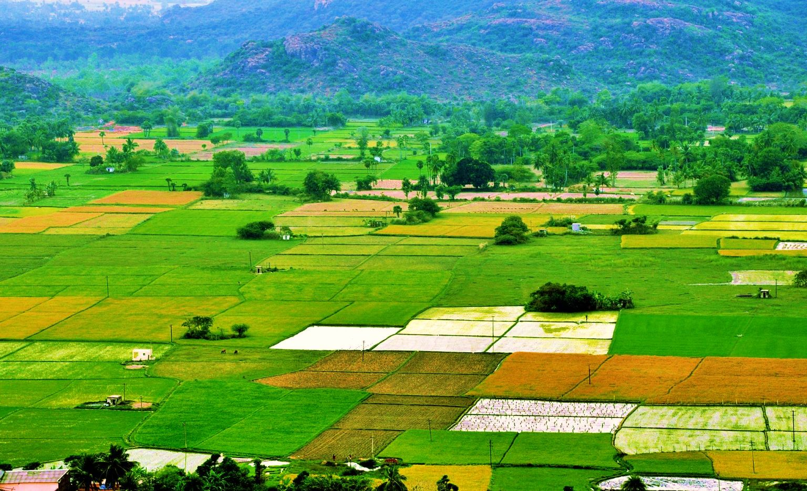
Introduction:
Domain: Our Domain Is Based On Agricultural and Global Country Population Analysis.
For our project we are mainly focusing on the intricate relationships between geosciences and social sciences.
We plan to gain better knowledge about these domains from those relationships. Our aim is to create trends, patterns for the various attributes from the both the domains we choose.
And we will provide a valuable insight based on the visualization.

Slide 3
Workflow
Data Collection:
We are choosing the data as agriculture and global country population from the Kaggle
Initial Visualization:
Firstly, we are utilizing the D3.js for the dataset which is uncleaned to visualize and giving a quick look at the information's format and potential insights.
Data Cleaning:
Here we are utilizing Python language in that we are utilizing various libraries like Pandas and NumPy to clean the dataset, and handling missing values, outliers, checking the data is there any inconsistencies.
Refined Visualization:
Here we are utilizing Python's data visualization libraries such as Matplotlib or Seaborn to generate more refined visualizations based on the cleaned dataset, focusing on specific variables of interest.
Dashboard Creation:
Here we are Utilizing Microsoft Power BI to perform interactive dashboards and reports, Using enhanced visualizations to present a complete picture of the analyzed data.
Report Generation:
Generating detailed reports outlining the analysis outcomes, ideas, and recommendations derived from the visualization and data analysis processes.

Slide 4
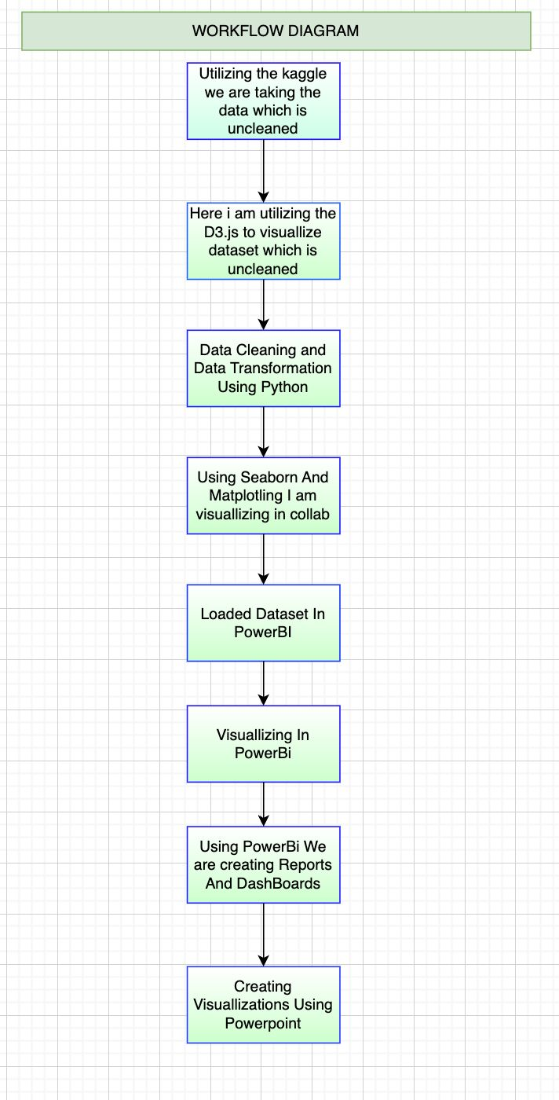

Slide 5
Data Abstraction-Attributes and Types
Agricultural Data
Type: Tabular data
Attributes:
Crop Area (float): Area of Land using for growing different crops
Production (float): Total production of crops.
Yield (float): Yield of crops per unit area.
State (string): The name of the state.
Detailed Description:
This dataset contains structured data related to agriculture, including crop area, production quantity, and yield for different states. It provides insights into agricultural productivity and land usage patterns across regions.
Global Country Data
Type: Tabular data
Attributes:
State (string): The name of the states.
Population (integer): Total population of the states.
Sex Ratio (float): The ratio of males to females in the population.
Literacy Rate (float): Percentage of the population that is literate.
Urban Population (float): Percentage of the population living in urban areas.
Rural Population (float): Percentage of the population living in rural areas.

Slide 6
Data Abstraction-Description
Dataset 1 (Global Country Data): Here Global Country Data Consists of attributes like State, Population, Sex Ratio, Literacy Rate, and Urban Population.
Number of Records (Global Country Data): 34 records representing various states and it is having 14 columns
Dataset 2 (Agricultural Data): Agricultural Data is a structured data it is containing crop-related attributes such as Crop Area, Production, and Yield for different states.
Number of Records (Agricultural Data): 1600 records and with 80 columns corresponding to different crops and states.
Data Transformation: Minimal transformation was done, such as converting data types and handling missing values.

Slide 7
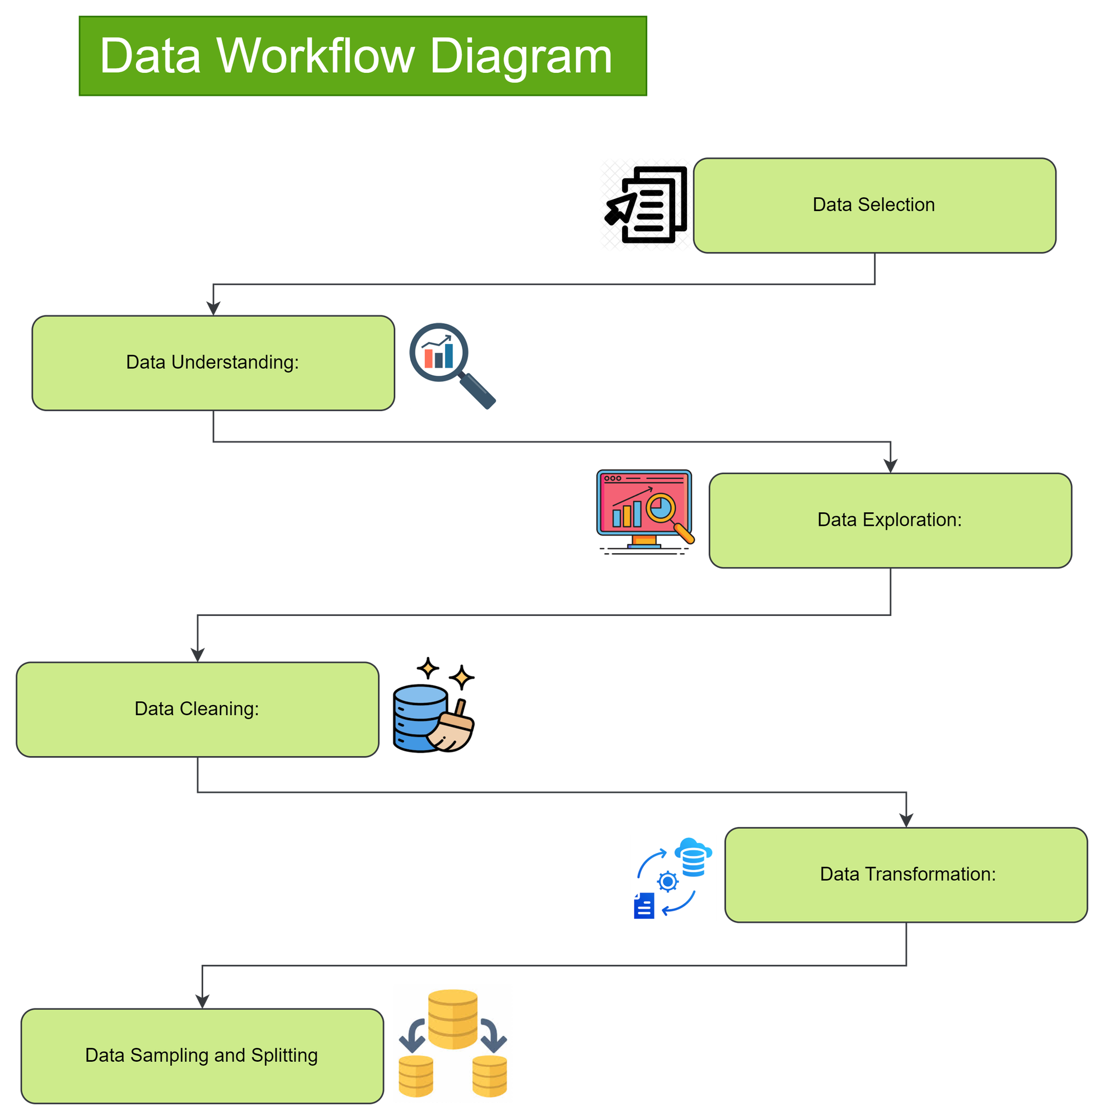

Slide 8
Data Abstraction-Transformation
In this project we performed the data transformation process It requires just minor changes, such as altering data types as well as handling missing values and aggregating the data filtering the data.
It includes converting categorical variables to numerical format if it is necessary And filling the data of missing values with appropriate procedure like mean or median imputation and ensuring consistency in data formats across attributes.
Additionally, We will be performing the outlier detection and Remediation may be used to ensure the accuracy of data prior to analysis.

Slide 9
Task Abstraction
Task: Here we are Analyzing agricultural data and Global country data to identify trends and patterns for various attributes
Target: Here we will gain insights into agricultural production, Usage of land and Literacy rate, percentage of total population etc.
Actions:
Data Collection
Data cleaning and preprocessing.
Visualization of agricultural and Global Country Data Utilizing Python
We will create interactive Dashboards for various trends and patterns utilizing powerBi.
Correlation analysis between agricultural and Global Country data.
We employ D3.js to demonstrate the visualizations with interactive on the web

Slide 10
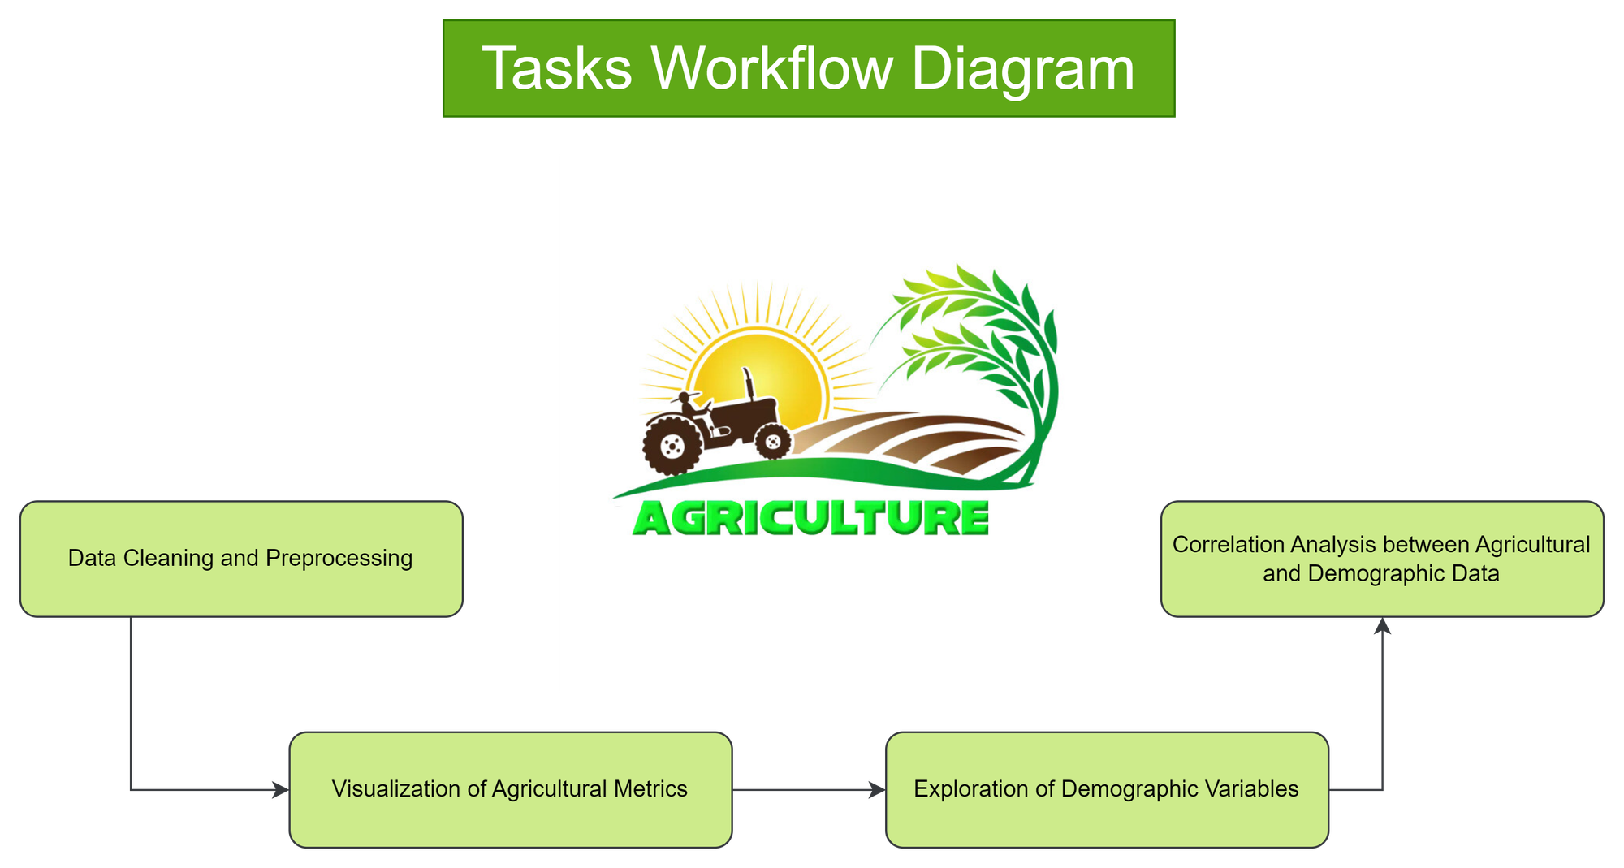

Slide 11
Task Abstraction-Workflow Explanation
The workflow starts with data cleaning and preprocessing to ensure the quality of the data for analysis.
Then, we moves on to visualize agricultural metrics to understand trends and patterns in agricultural production.
After that, we explores demographic variables to gain insights into the population characteristics.
Then we performs correlation analysis to uncover relationships between agricultural and demographic factors.

Slide 12
Implementation using Tools:
D3.js:
We used the D3.js to visual the initial data which was not cleaned and D3.js has provided a stage to create interactive charts and graphs directly in the web browsers.
Usage: By using the D3.js we explored the patterns and relations present in the dataset by creating various visualizations such as bar chart, scatterplots etc.
Python:
Python is used mainly for the data pre-processing and various libraries such as Matplotlib and Seaborn are used to understand and visualize the data.
Usage: For the data pre-processing the pandas and bumpy libraries were used and they also handled all the inconsistencies present in the data and all the visualizations were created with the help of Matplotlib and Seaborn on the data which was cleaned, through this we were able to present the valuable insights through a number of charts and plots each with its own insight about the agricultural sector.
Microsoft Power BI:
We used the Power BI mainly to create interactive dashboards which would have different visualizations such as maps, plots and charts. And then by using Power BI these different sets of data could be connected which gives a more complete picture of what’s happening.
Usage: By using Power BI we integrated various visualizations and also created relationships between them. By integrating the visualizations we can see how they interact when a change is made on one visualization and observe its effect on the other visualization and vice-versa, so by this we can gain a deeper understanding of the data.

Slide 13
Results for Analysis

Slide 14
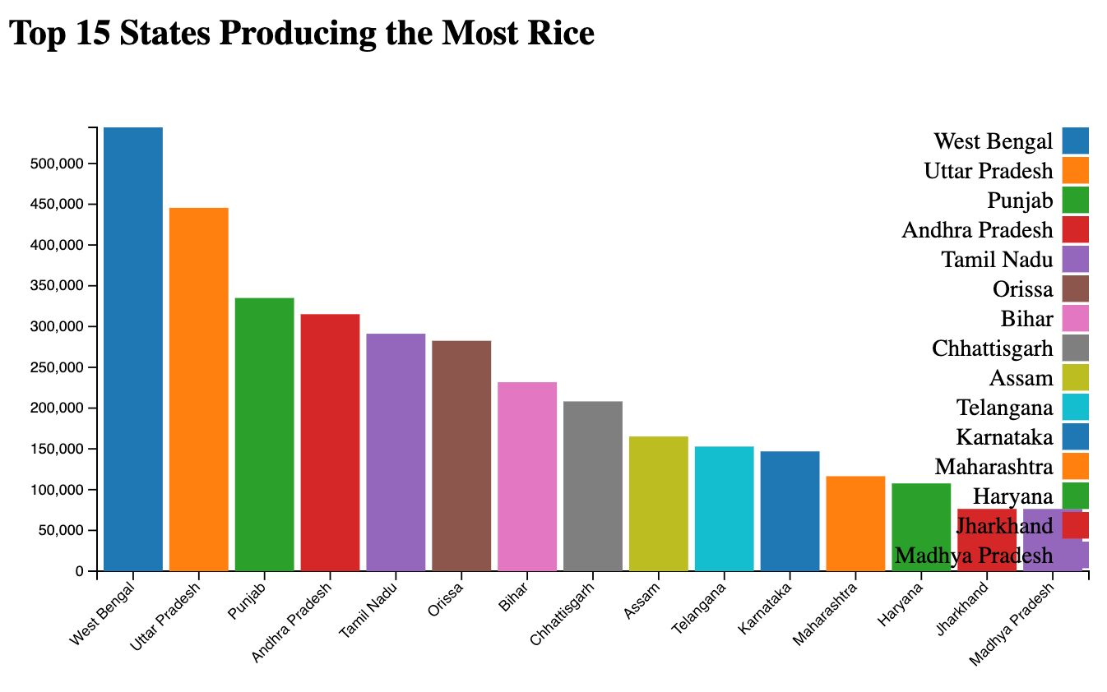
Initially Using D3.js To Visualize
Top 15 States Producing the Most Rice Visualizing Utilizing The Bar Chart):
Explanation:
In this bar chart the top 15 Indian States with most rice production are displayed.
As we can observe West Bengal has the highest rice production whereas Madhya Pradesh and Jharkhand have the lowest rice production.
In this visualization the states with highest yield such as West Bengal, Uttar Pradesh and Punjab are highlighted.
This visualization emphasizes the regional differences in agriculture and an important role these states play to ensure national food security.

Slide 15
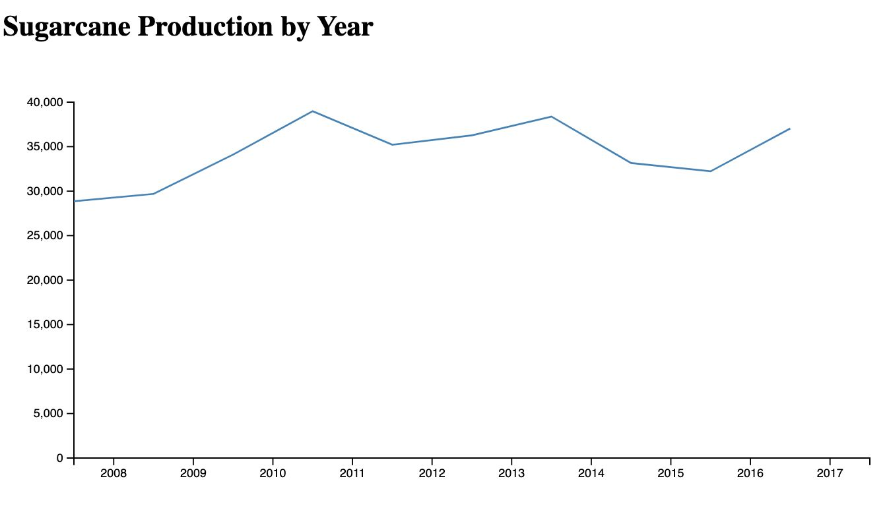
Initially Using D3.js To Visualize(cont.)
Sugarcane Production Over the Last 9 Years (Line Chart):
Explanation:
The line chart tracks the sugarcane production trends over the past decade, offering insights into the industry's performance over time..
Sugarcane cultivation is a vital component of India's agricultural landscape, supporting both rural livelihoods and the sugar industry.
This visualization tracks production variations over the years, indicating factors like weather patterns, policy changes, and market demand influencing sugarcane yields.
It provides valuable information for stakeholders, policymakers, and farmers to understand trends and make informed decisions.

Slide 16
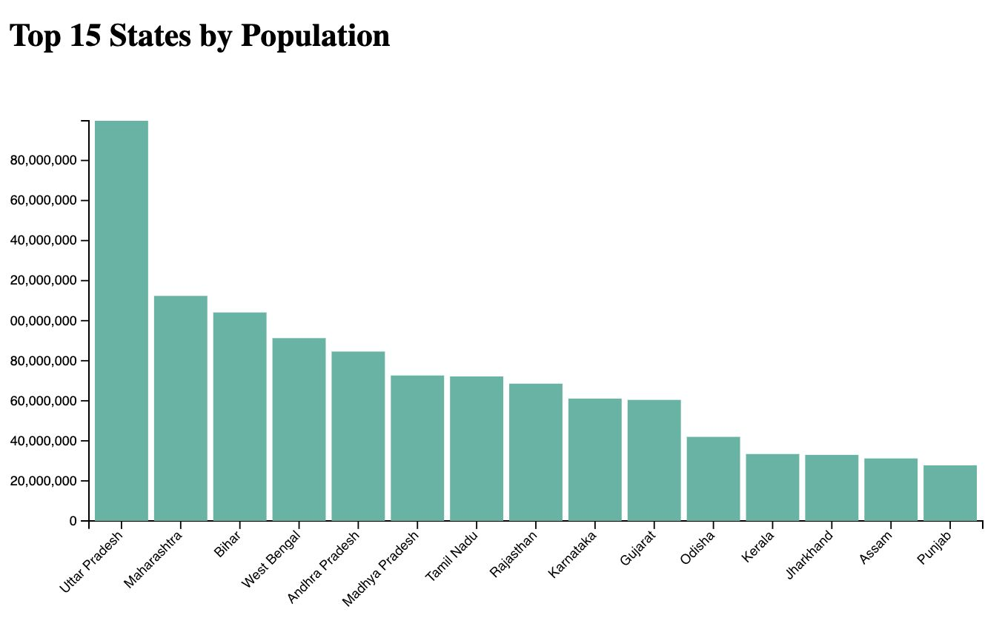
Initially Using D3.js To Visualize(cont.)
Top 15 States by Population (Bar Chart):
Explanation:
In this bar chart we visualized the top 15 states with most population. By knowing this we can find out the needs of each state in terms of their food needs and the yield they produce and so on..
India’s population is very big and it varies from state to state and in this visualization such states with high population such as Uttar Pradesh, Maharashtra, and so on.. are shown.
In this visualization population across different regions of the country are visualized showcasing the importance of each state.

Slide 17
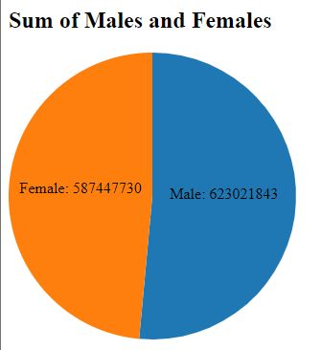
Initially Using D3.js To Visualize(cont.)
Sum of Males and Females (Pie Chart):
Explanation:
To know the gender distribution we are using a pie chart to visualize the male population and female population in India.
By looking at the pie chart , the visualization displays the gender balance of the country.
After looking at the chart we can see that there are slightly more males than females. This represents many aspects of life in India, such as societal dynamics, economic participation and social structure.

Slide 18
Now using Python To Preprocess and Visualize
Combined Distribution of Rice and Wheat Production:
Explanation:
The distribution of wheat and rice production levels and cultivated areas across various Indian states and regions is shown in this composite illustration.
It is feasible to compare the production and area of various staple crops through the use of the histograms to describe this data.
The production of rice and wheat, two of India's main cereal crops, is essential to the nation's agricultural environment.
This visualization captures the many agricultural methods and difficulties encountered in ensuring food security and sustainability, ranging from areas with significant rice farming to those who specialise in wheat production.

Slide 19
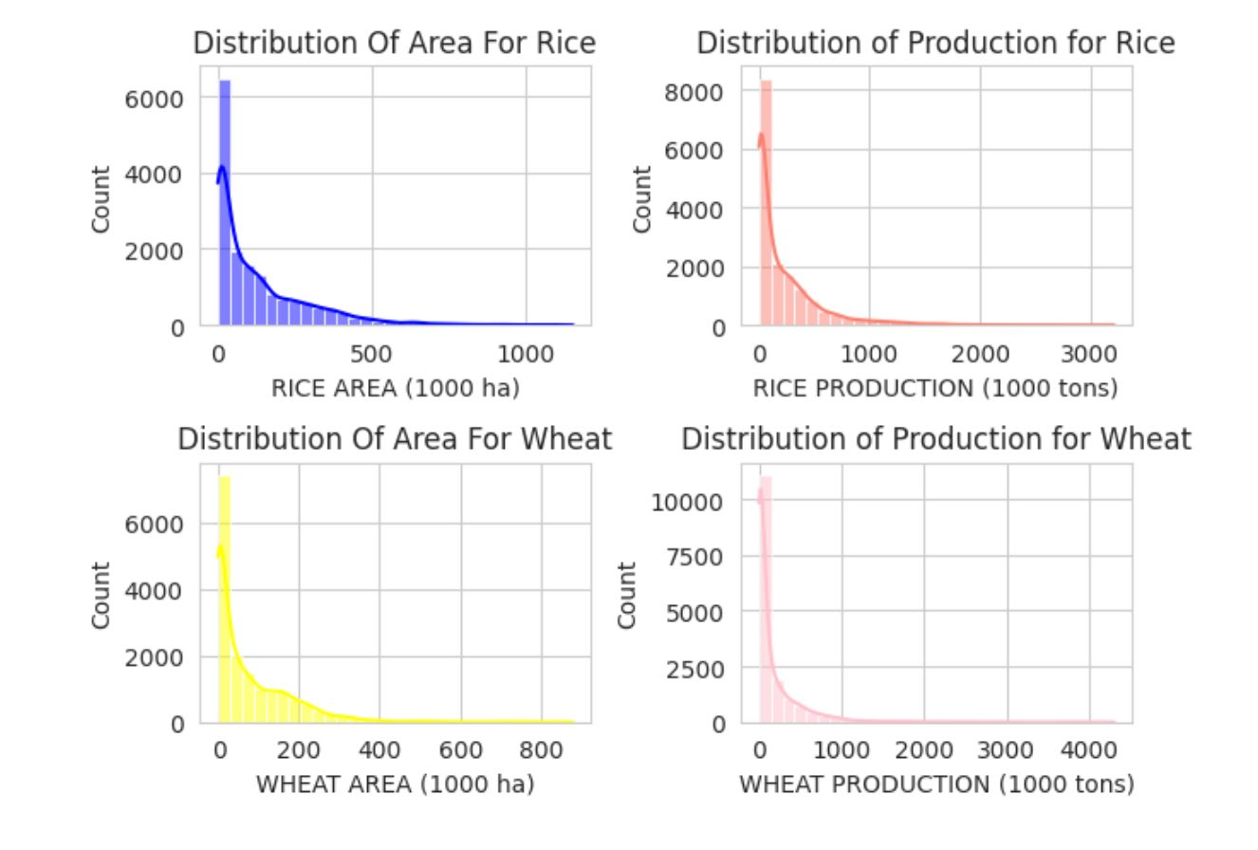

Slide 20
Visualizing Using Python and Its Libraries:
Combined Distribution of Rice, Wheat, and Sugarcane Cultivation Areas:
Explanation:
Using box plots, this illustration shows how rice, wheat, and sugarcane agricultural areas are spread out across India's many states.
The dispersion and variability of cultivated areas for each crop are shown by a box plot, making it simple to make comparisons and recognize outliers.
Due to variations in temperature, soil types, and farming methods, the cultivation areas of rice, wheat, and sugarcane—three important crops in India's agricultural sector—vary greatly all through states.
This graphic shows the varied agricultural terrain of India, ranging from states with extensive rice farming to areas focused on wheat or sugarcane production, and the distinct challenges that each state has in ensuring both food security and economic viability.

Slide 21
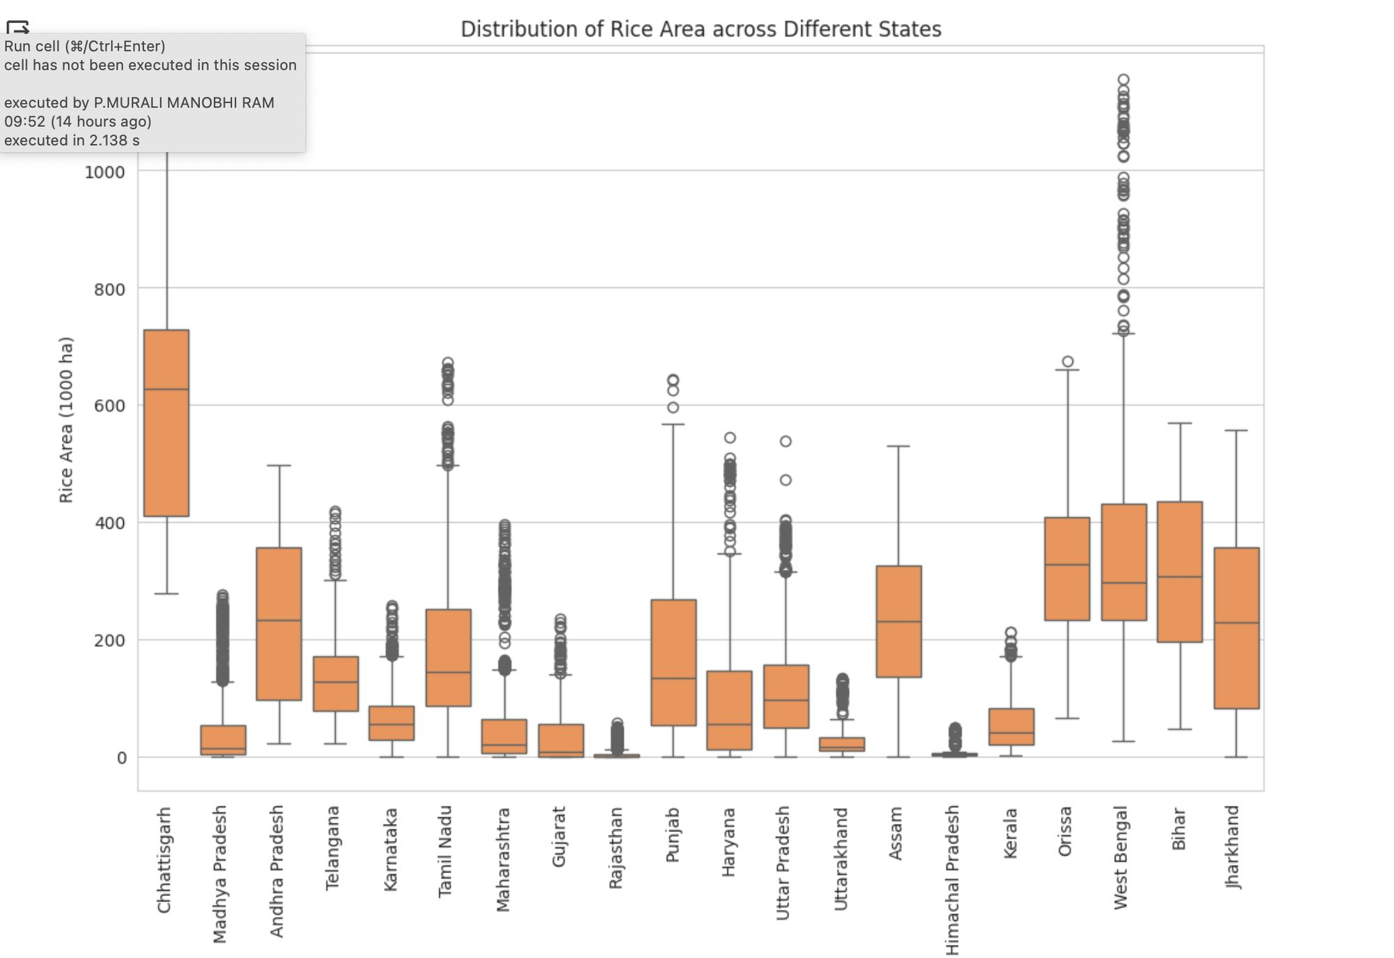
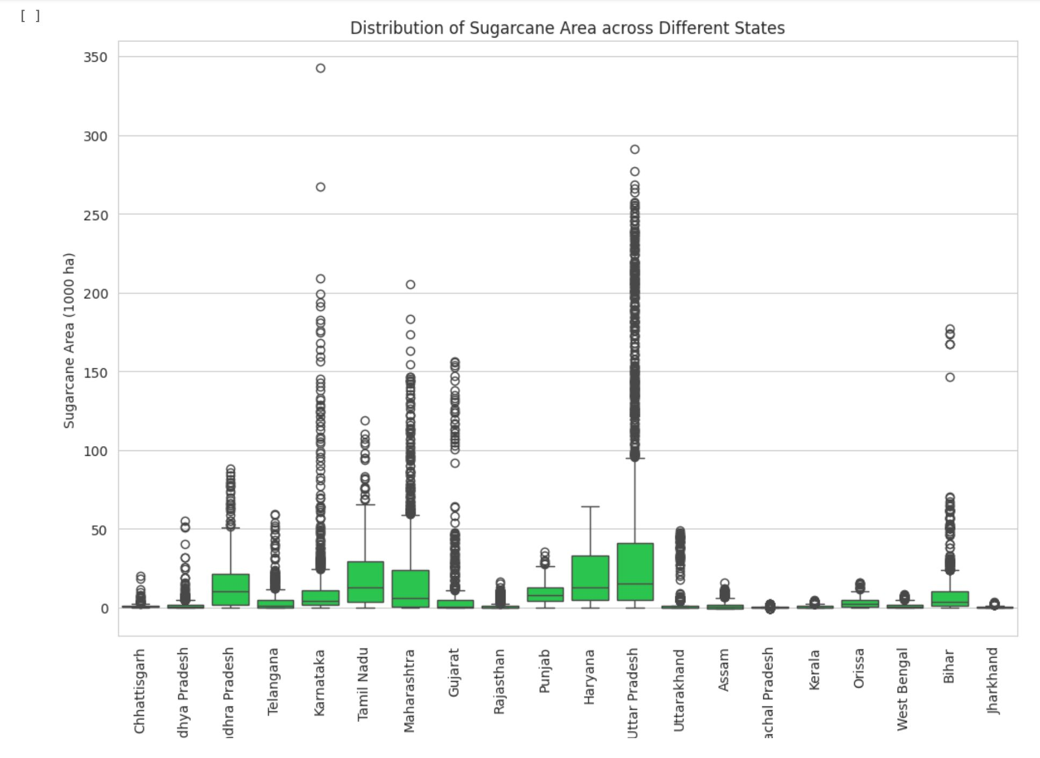
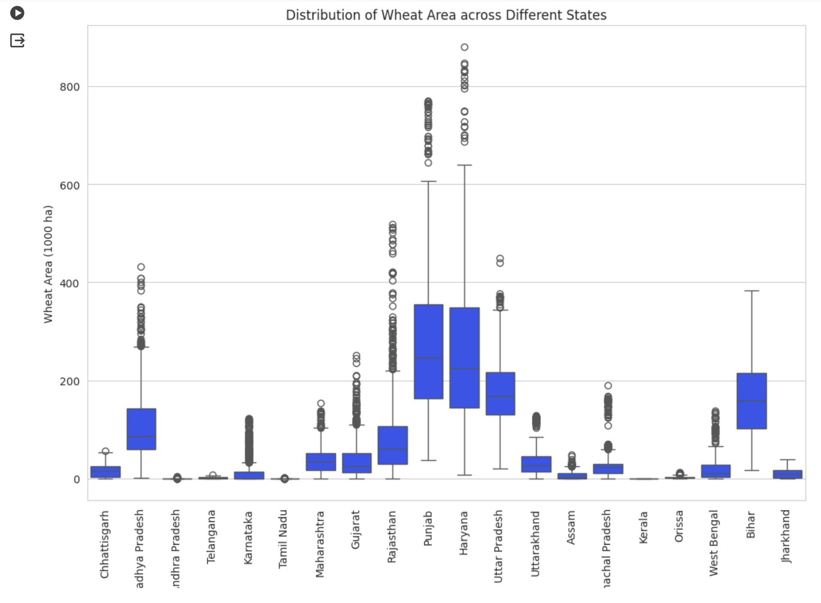

Slide 22
Visualizing Using Python and Its Libraries:
Combined Distribution of Rice and Pearl Millet Cultivation Parameters:
Explanation:
Scatter plots of coupled agricultural characteristics, such as area and production, for a variety of crops, including rice, Pearl Millet are shown in this graphic.
A knowledge of the relationship between crop yield and cultivation area may be gained through examining the scatter plots.
The wheat, Pearl Millet scatter plots offer useful data on the dynamics of crop cultivation, assisting stakeholders in comprehending the factors influencing agricultural productivity.
In order to increase crop yields and guarantee food security, agricultural policy, resource allocation, and crop planning may all benefit from strategic decisions that are influenced by these visualizations.

Slide 23
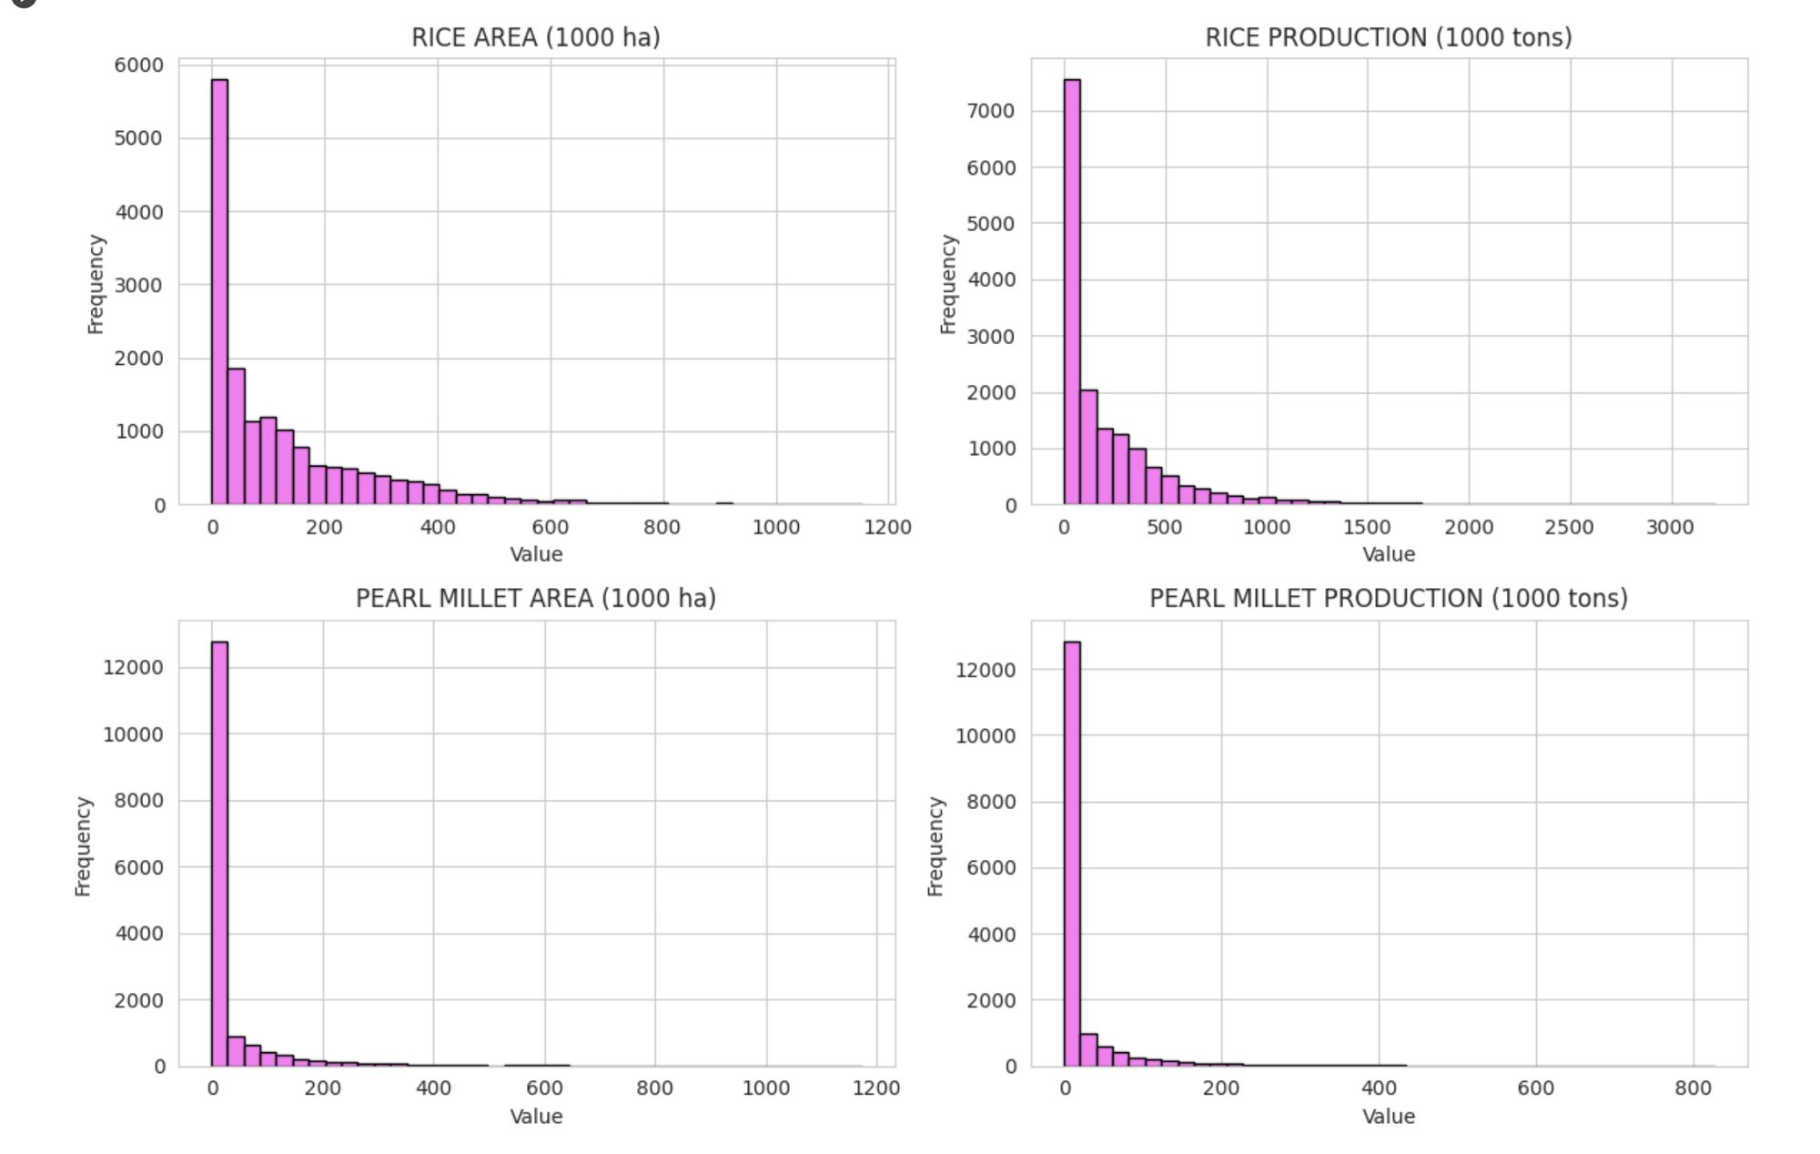

Slide 24
Visualizing Using Python and Its Libraries:
Combined Scatter Plots of Agricultural Parameters:
Explanation:
Scatter plots of coupled agricultural characteristics, such as area and production, for a variety of crops, including rice, wheat, maize, and sugarcane, are shown in this graphic.
A knowledge of the relationship between crop yield and cultivation area may be gained through analyzing the scatter plots.
The wheat, maize, and sugarcane scatter plots offer useful data on the dynamics of crop cultivation, assisting stakeholders in comprehending the variables affecting agricultural productivity.
In order to increase crop yields and guarantee food security, agricultural policy, resource allocation, and crop planning could all benefit from strategic decisions that are driven by these visualizations.

Slide 25
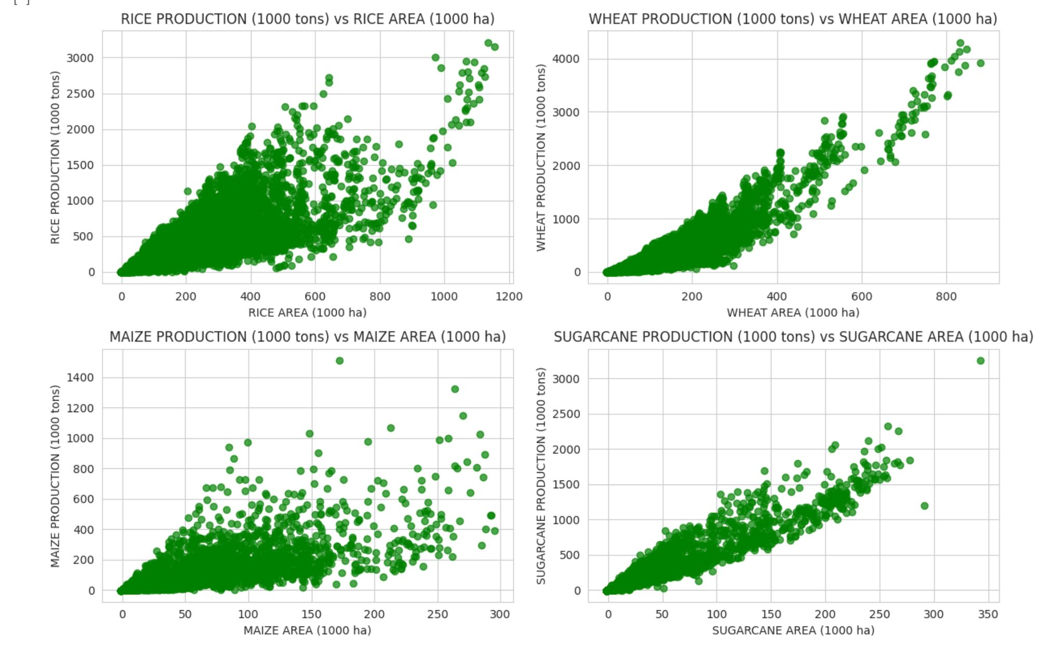

Slide 26
Visualizing Using Python and Its Libraries:
Combined Histograms of Minor Pulses, Wheat Area, Ground Nut Area , Sugar Cane Area :
Explanation:
The distribution of agricultural factors, such as the area under cultivation for sugarcane, Ground Nut, wheat, and wheat, is displayed graphically in this image.
The distribution of a certain crop's production area across various locations is depicted by each subplot.
The histograms offer substantial data on the patterns of area under cultivation distribution for different crops. The rice cultivation area histogram, for instance, exhibits a skewed distribution, meaning that certain locations have noticeably bigger rice cultivation fields than others.
In the same way, the histograms of sugarcane, wheat, and maize give data on the regional variations in the amount of land used for agriculture. Policymakers, academics, and other agricultural stakeholders can better understand the spatial distribution of yields of crops and pinpoint areas with particular agricultural characteristics through analyzing these distributions.

Slide 27
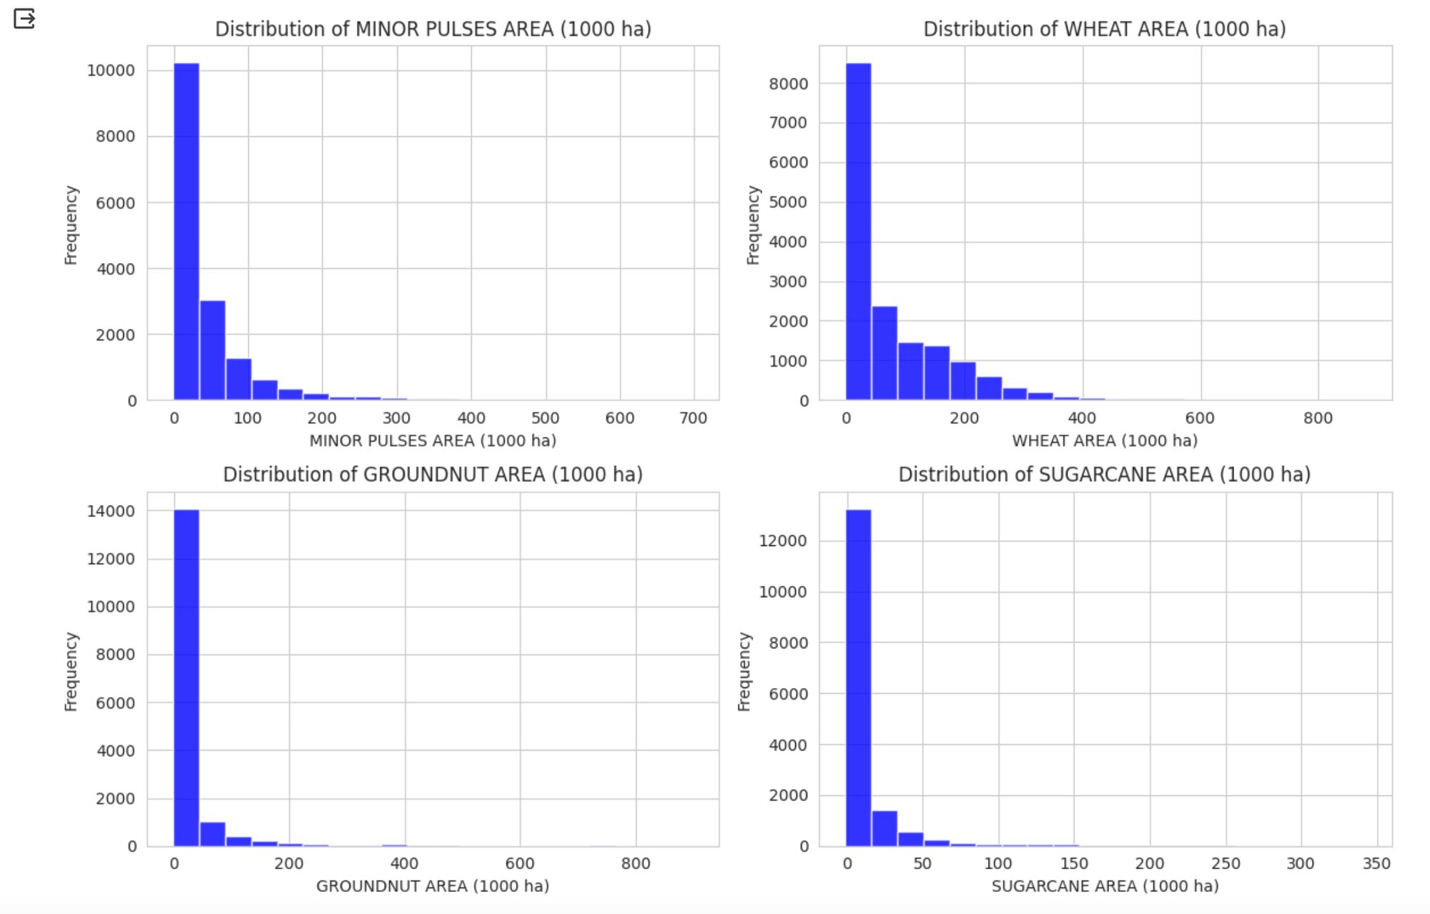

Slide 28
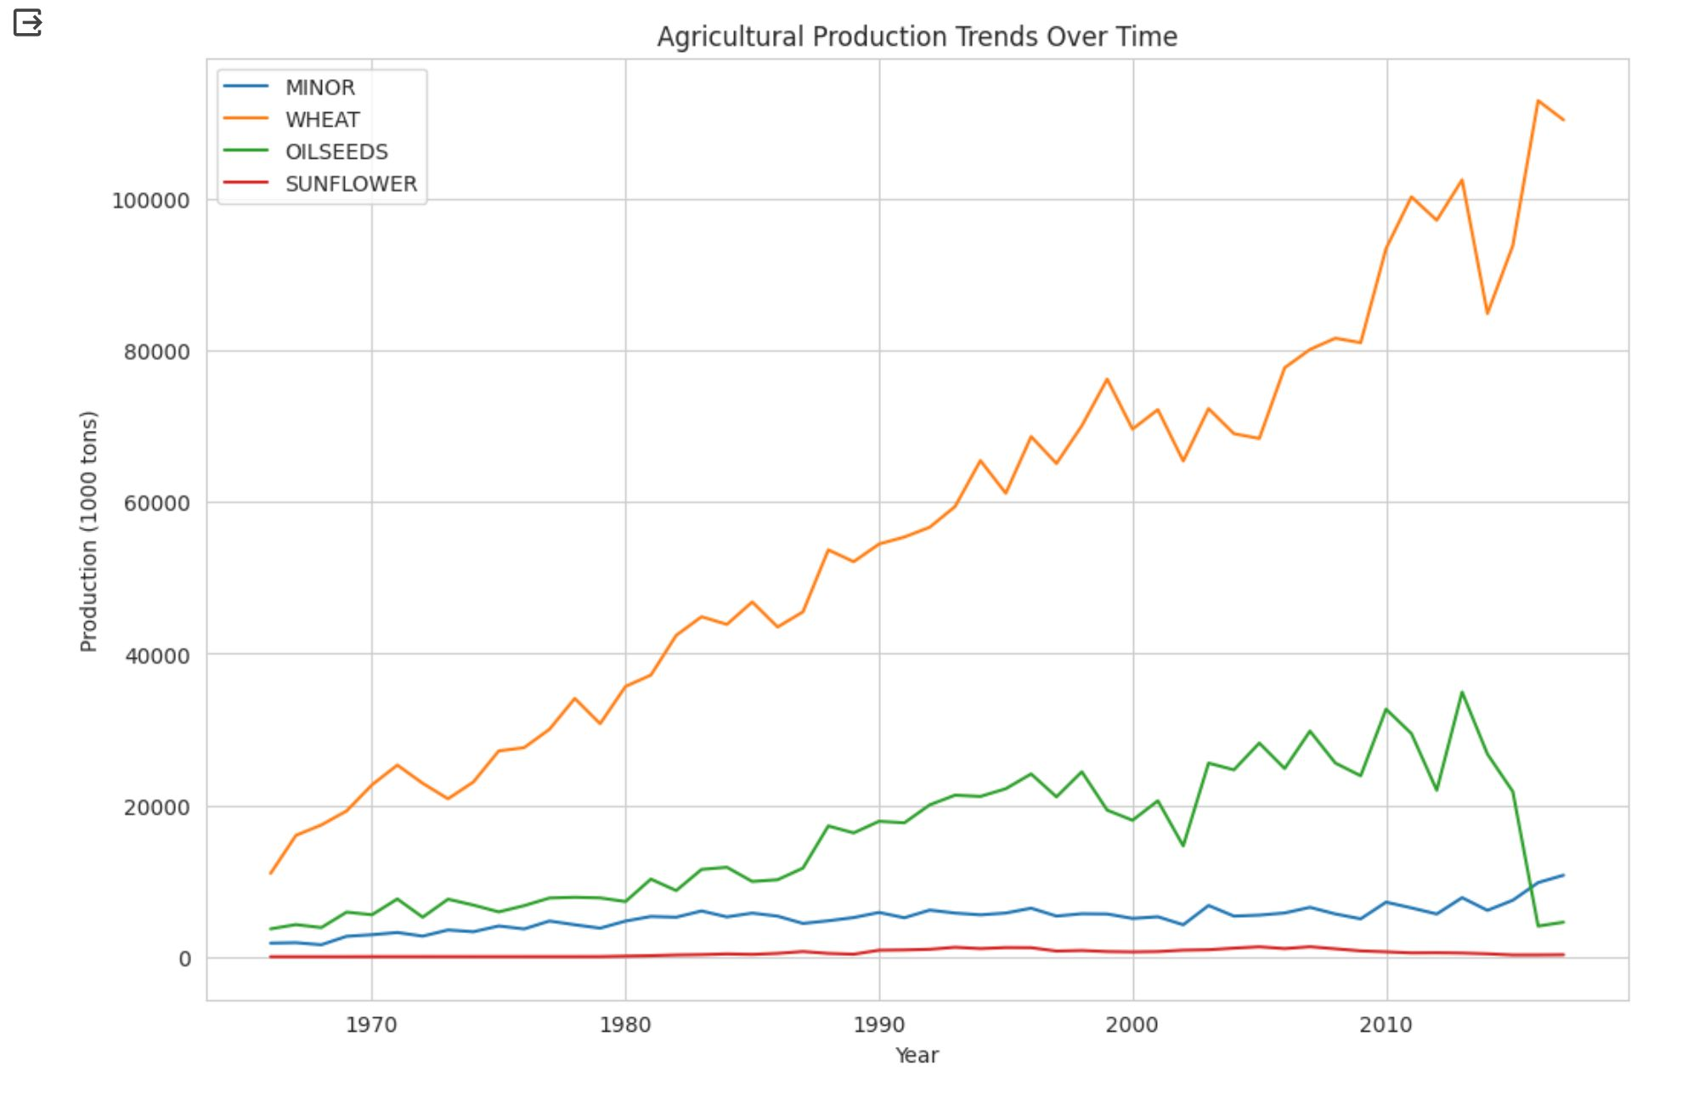
Visualizing Using Python and Its Libraries:
Agricultural Production Trends Over Time:
Explanation:
The patterns in agricultural output for four important crops—Minor Pulses wheat, Oil Seeds, and Sunflower—over time are depicted in this graphic.
The overall output (measured in 1000 tons) for the various years is used to illustrate the production patterns.
It displays variations and patterns in each crop's yield, emphasizing times of expansion, stalling, or reduction.
Stakeholders may foresee future production issues, create plans to increase productivity, and guarantee a strong and resilient agricultural sector to fulfill the expanding demands of a fast changing global population by analyzing these patterns.

Slide 29
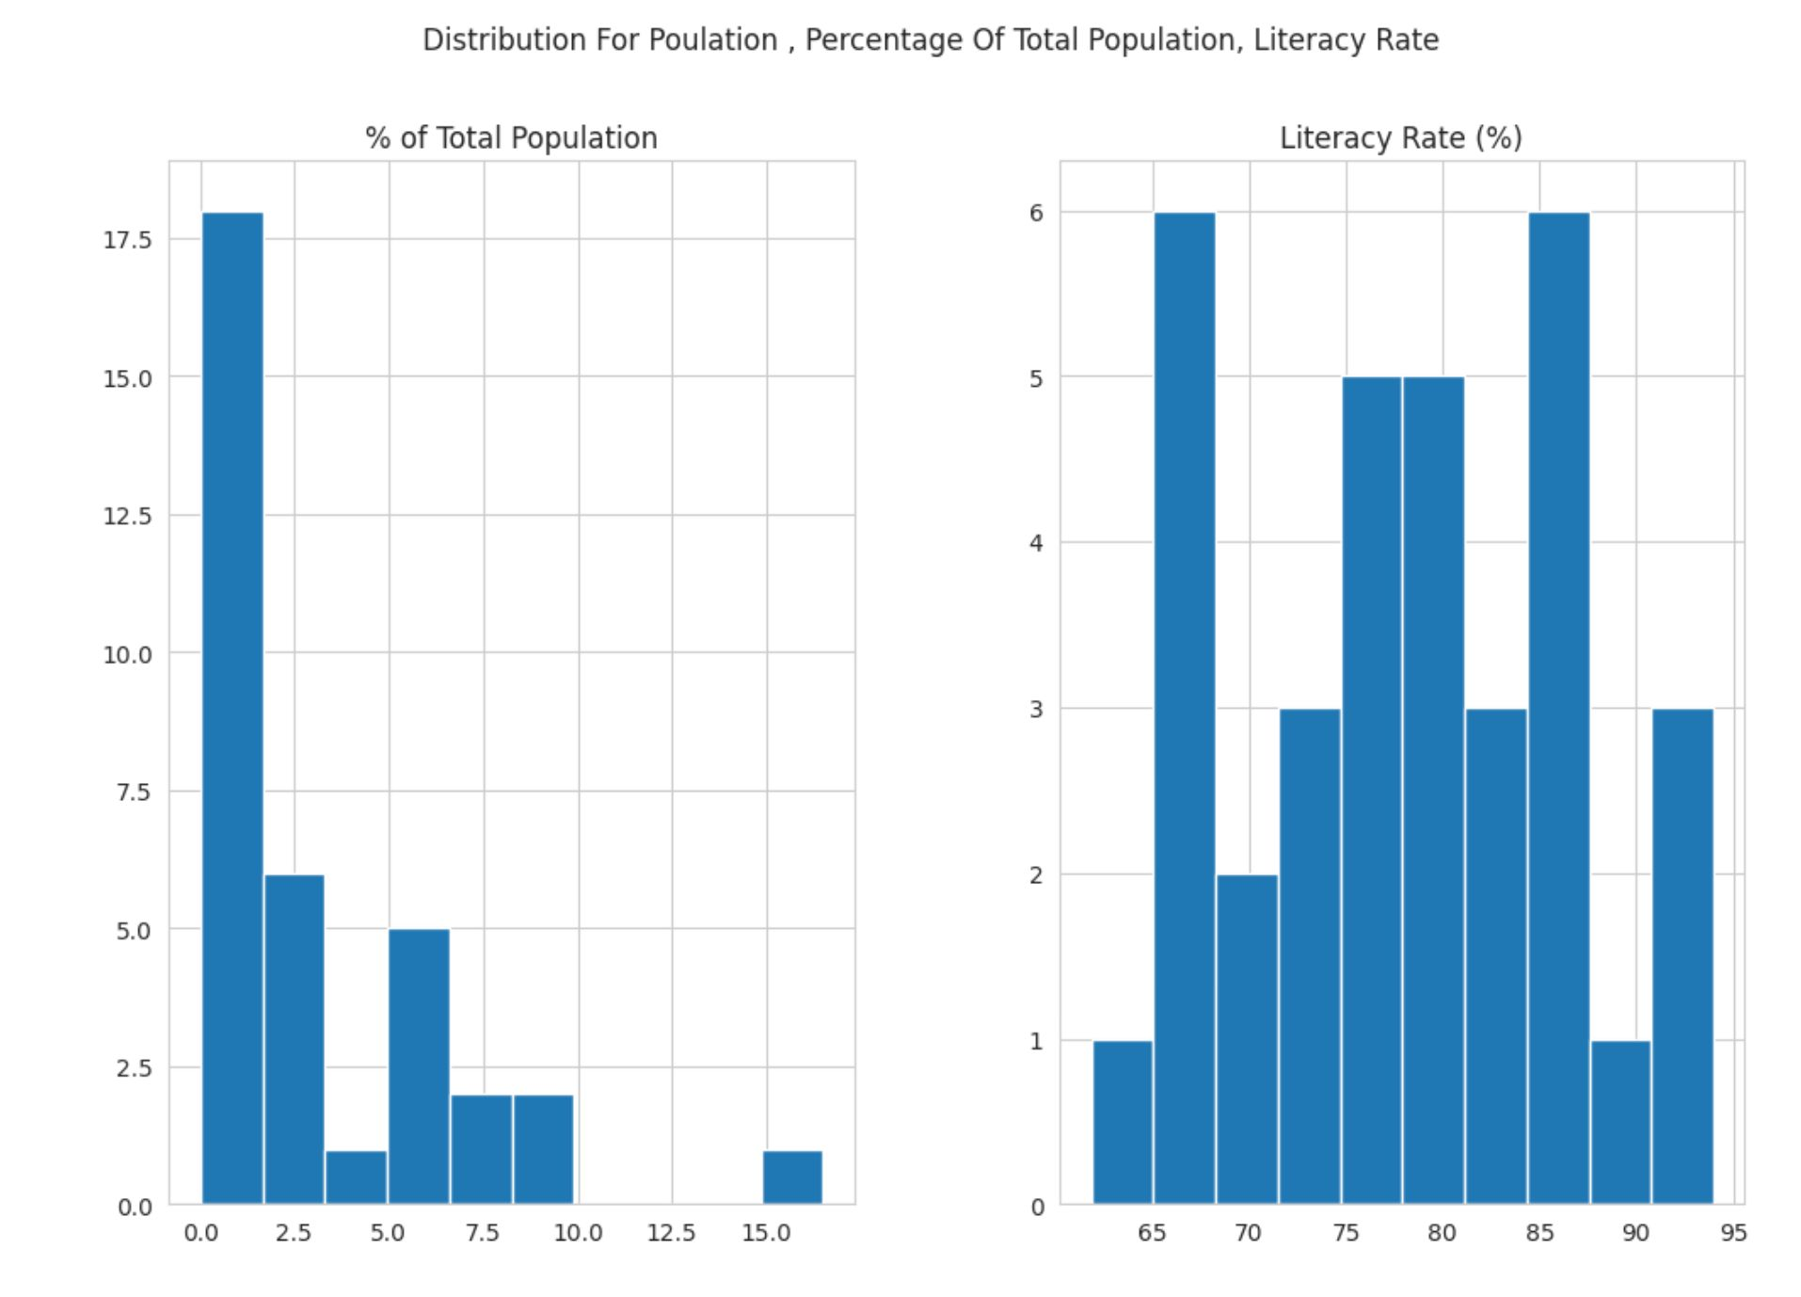
Visualizing Using Python and Its Libraries:
Distribution of Population Literacy rate:
Explanation:
This collection of histograms displays the distribution of important demographic numerical characteristics among various areas or entities, such as population, population percentage of total population, and rate of literacy.
We can learn more about the distribution of population percentages across areas, the variance and dispersion of population numbers, and the literacy rate distribution by looking at these histograms.
Recognizing these distributions enables the identification of population trends, evaluation of literacy rate inconsistencies, and guidance for policy decisions about social issues and fair development.

Slide 30
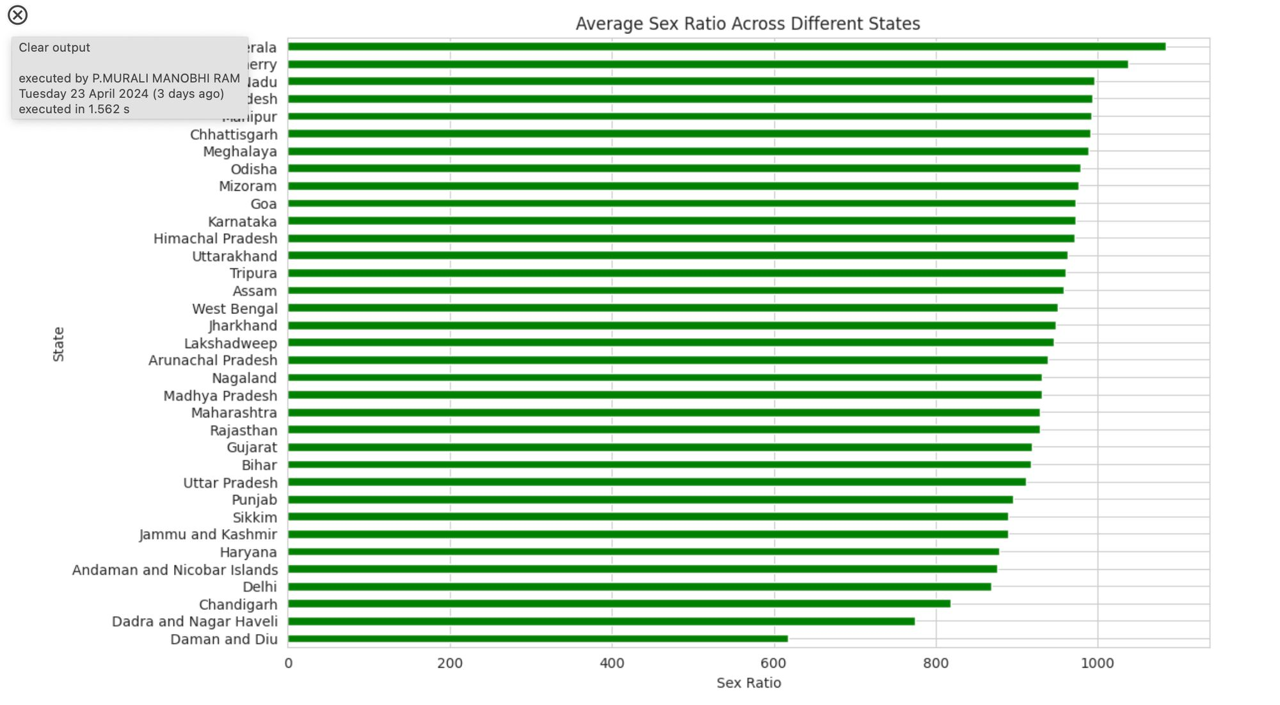
Visualizing Using Python and Its Libraries:
Average Sex Ratio Across Different States:
Explanation:
The average sex ratio for every state is represented in this horizontal bar chart, offering insights into geographic trends in gender distribution.
We can identify differences in gender distribution between states by looking at the average sex ratio.
Understanding these fluctuations enables the identification of regions with imbalanced gender ratios, maybe requiring concentrated efforts to advance gender parity and tackle underlying social and cultural factors influencing the distribution of genders.

Slide 31
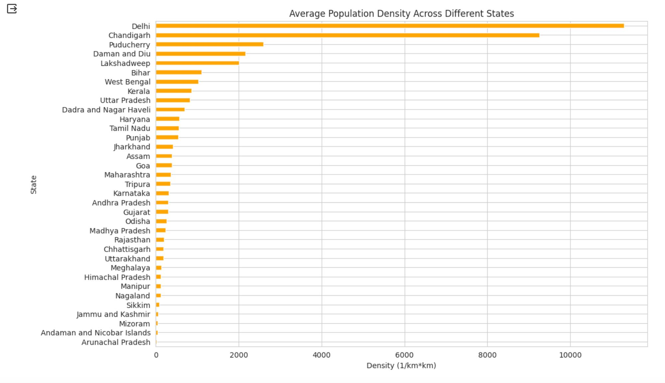
Visualizing Using Python and Its Libraries:
Average Population Density Across Different States:
Explanation:
The average population density for each state is shown in this horizontal bar chart, which sheds light on changes in urbanization and population dispersion.
We can identify differences in population concentration between states by looking at the average population density.
In order to handle expanding populations sustainably, areas with increased population densities may confront issues with infrastructure, resource allocation, and urban planning. This emphasizes the necessity for strategic development efforts.

Slide 32
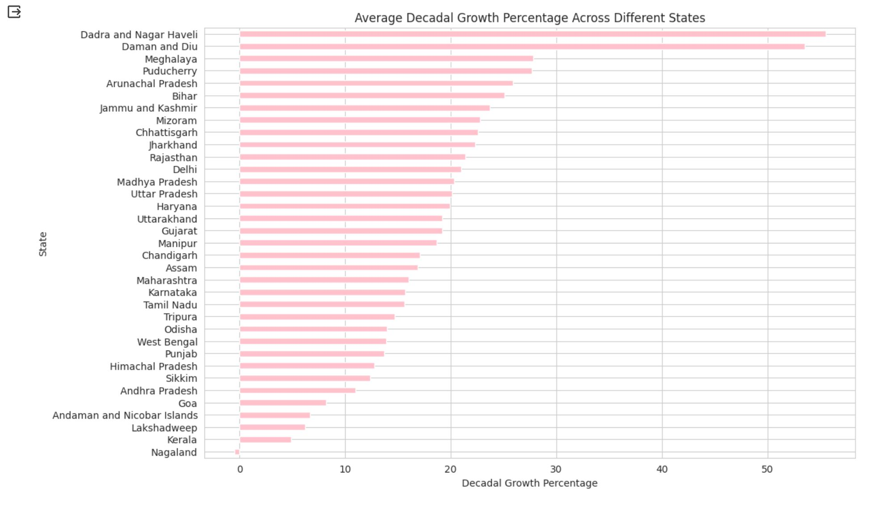
Visualizing Using Python and Its Libraries:
Average Decadal Growth Percentage Across Different States:
Explanation:
The average decadal growth % for each state is displayed in this horizontal bar chart, which offers insights into the population dynamics and trends in various areas during the previous ten years.
Through the analysis of average decadal growth percentage, we are able to comprehend the evolution of population dynamics in various states.
Higher growth rates can lead to faster urbanization, economic expansion, and social change in a state, which can affect how resources are allocated and what policies are made for future planning and development.

Slide 33
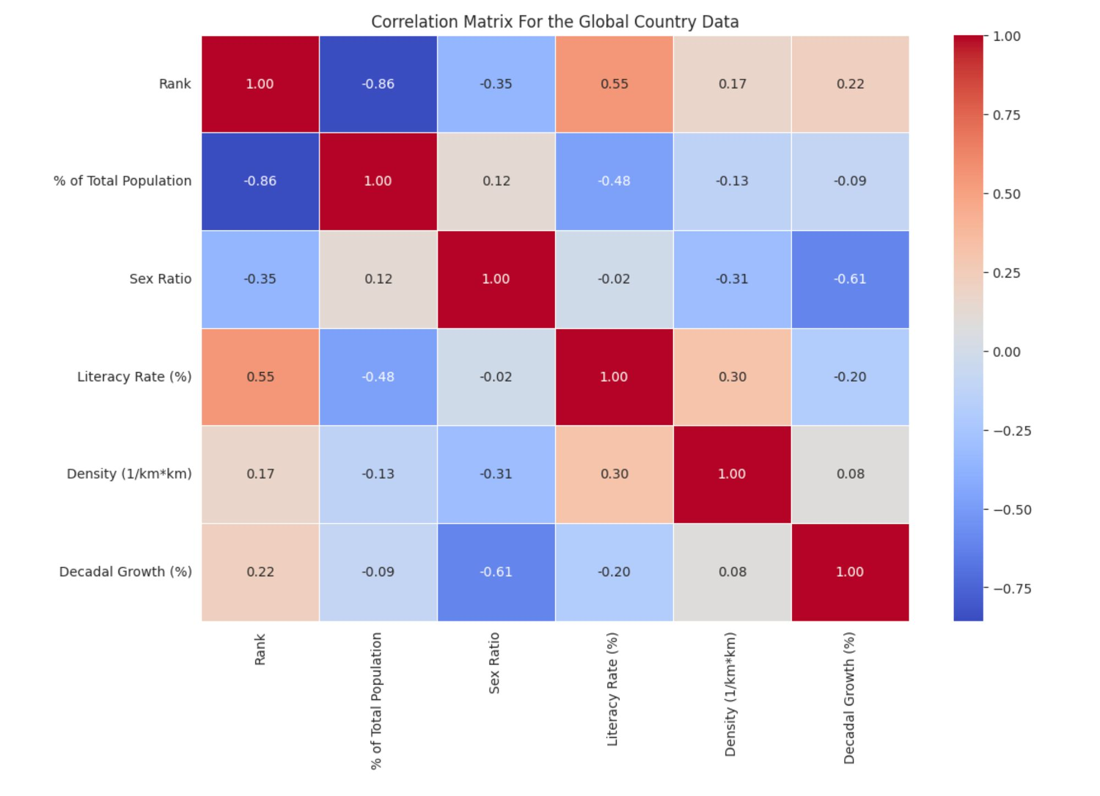
Visualizing Using Python and Its Libraries:
Correlation Matrix of Global Country Data:
Explanation:
The correlation matrix of many Global Country factors is displayed in this heatmap, emphasizing the direction and intensity of correlations between distinct numerical properties.
We may learn more about the relationships between demographic parameters by examining the correlation matrix.
Negative correlations show that variables move in the opposite direction from one another, whereas strong positive correlations signal that variables tend to rise or decrease together.

Slide 34
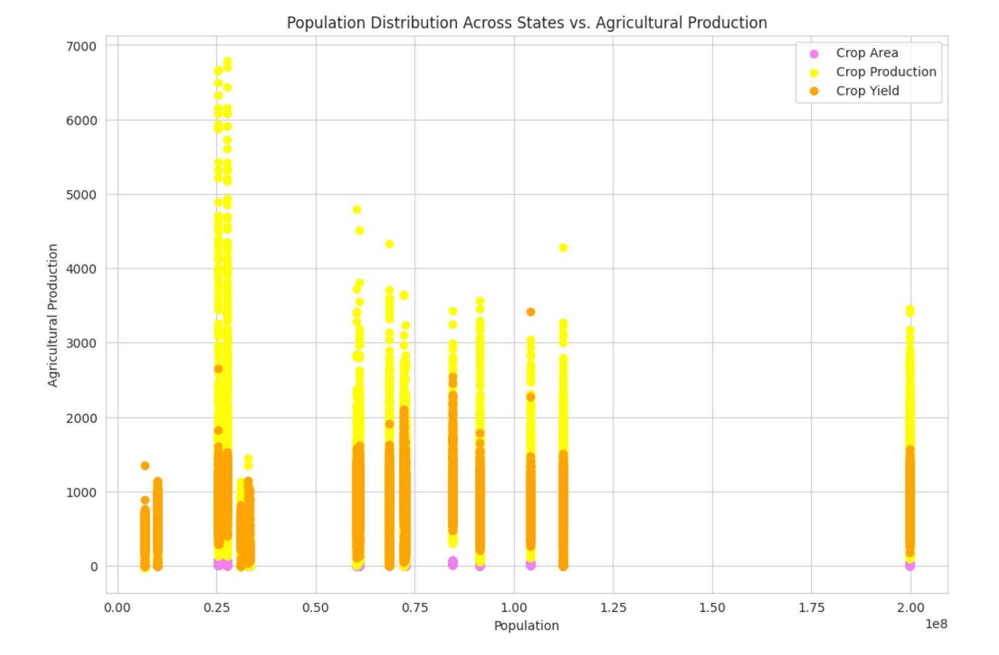
Visualizing Using Python and Its Libraries:
Population Distribution Across States vs. Agricultural Production:
Explanation:
The association between the population distribution throughout the states and many agricultural output indices, such as total crop area, total crop production, and average crop yield, is shown in this scatter plot.
We can identify trends in the relationship between population density and agricultural output by contrasting measures of agricultural productivity with population distribution.
In order to promote sustainable agricultural practices and food security, policymakers and stakeholders may make more informed decisions about infrastructure development, resource allocation, and agricultural policies by having a better understanding of these linkages.

Slide 35
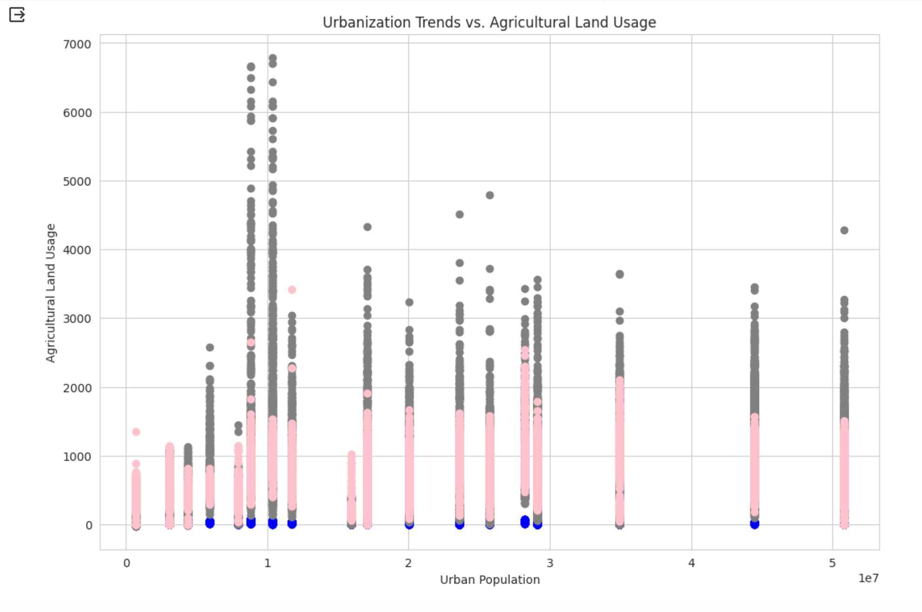
Visualizing Using Python and Its Libraries:
Urbanization Trends vs. Agricultural Land Use:
Explanation:
The association between urban population and agricultural land use measures, such as total crop area, total crop output, and average crop yield, is depicted in this scatter plot.
Agricultural land use patterns may vary as urbanization increases as a result of adjustments to labor force, economic priorities, and land availability.
Comprehending these patterns is essential for environmentally conscious agricultural and urban planning, guaranteeing that urban expansion does not jeopardize environmental sustainability or food security.

Slide 36
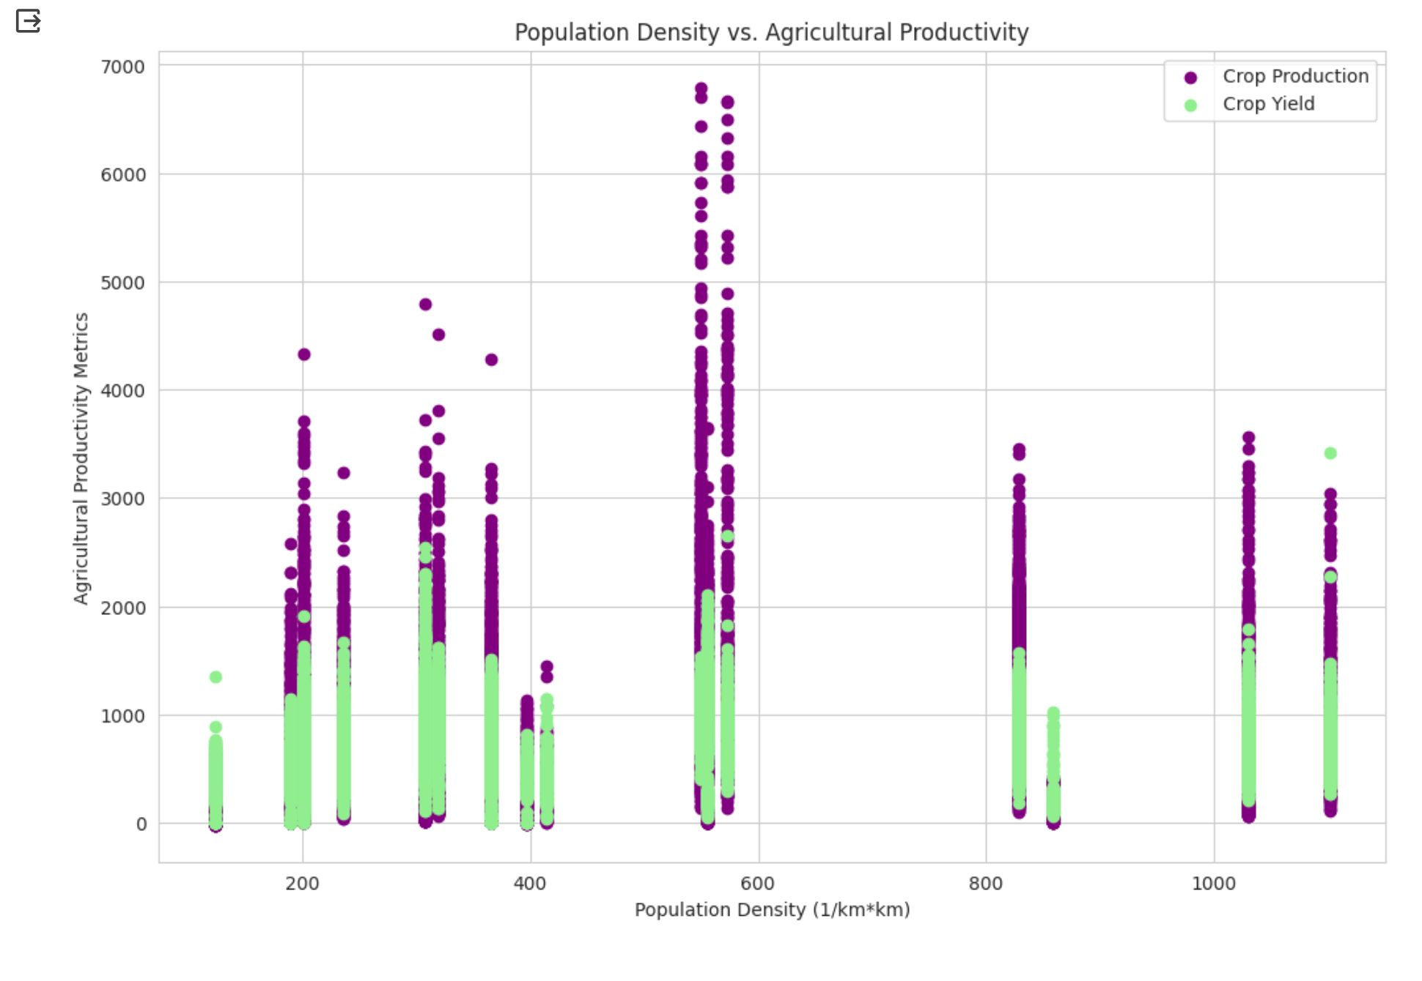
Visualizing Using Python and Its Libraries:
Population Density vs. Agricultural Productivity:
Explanation:
This scatter plot shows how agricultural productivity indices, such as total crop output and average crop yield, are correlated with population density...
Because there is a shortage of land and resources, locations with higher population densities may have trouble maintaining agricultural production. ..
To ensure food security for densely populated areas, governments must grasp this link in order to put measures into place that balance population development with sustainable farming methods.

Slide 37
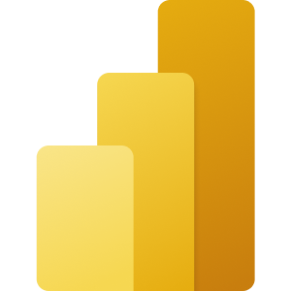
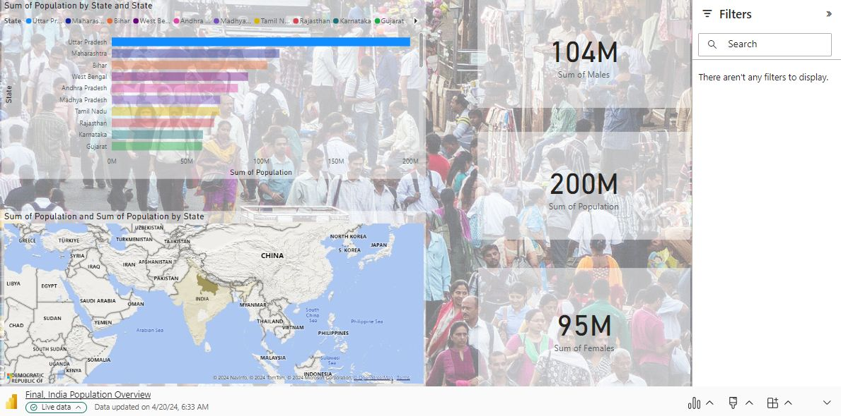
Microsoft Power BI

Slide 38
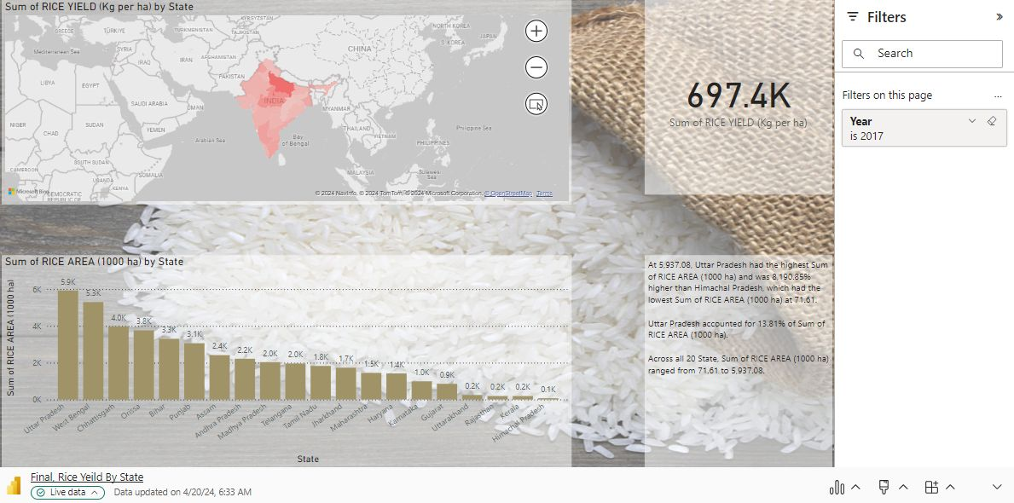
Microsoft Power BI

Slide 39
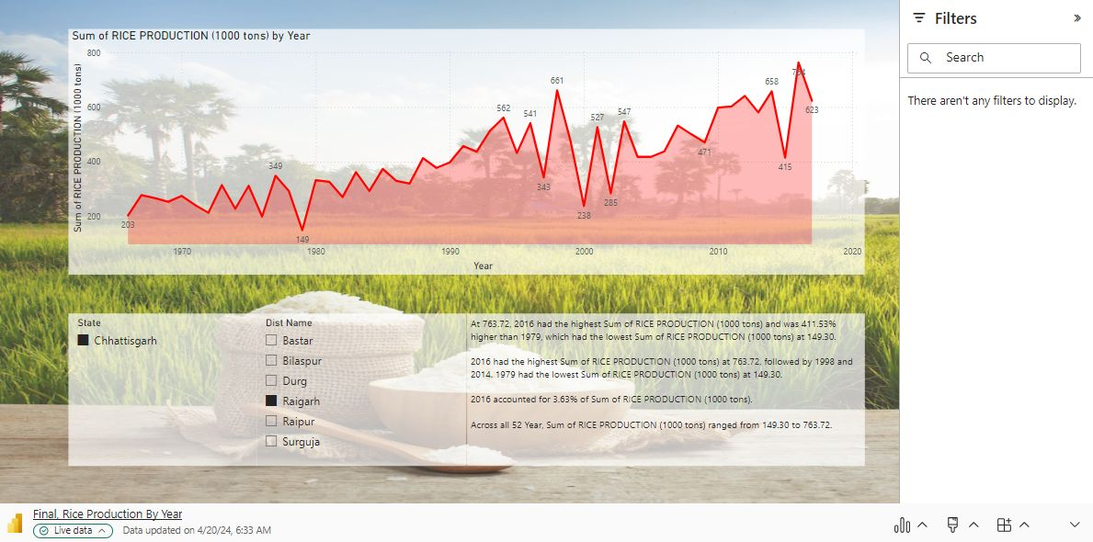
Microsoft Power BI

Slide 40
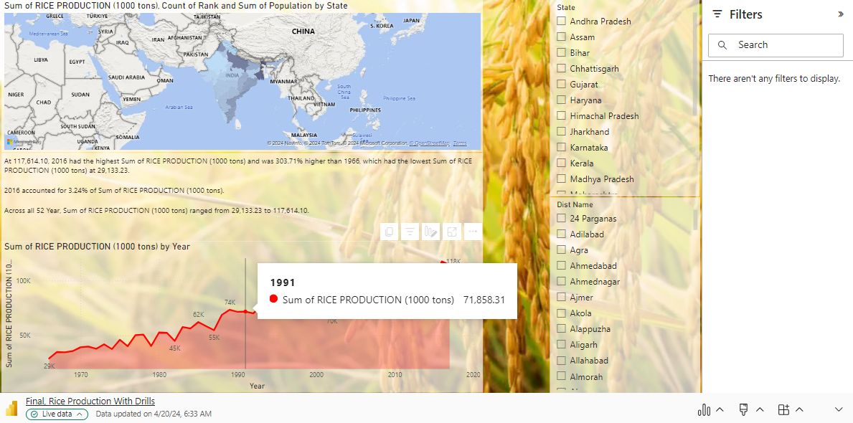
Microsoft Power BI

Slide 41
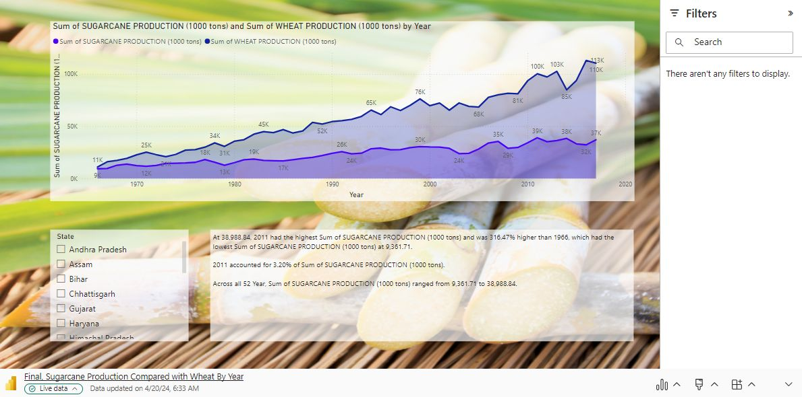
Microsoft Power BI

Slide 42
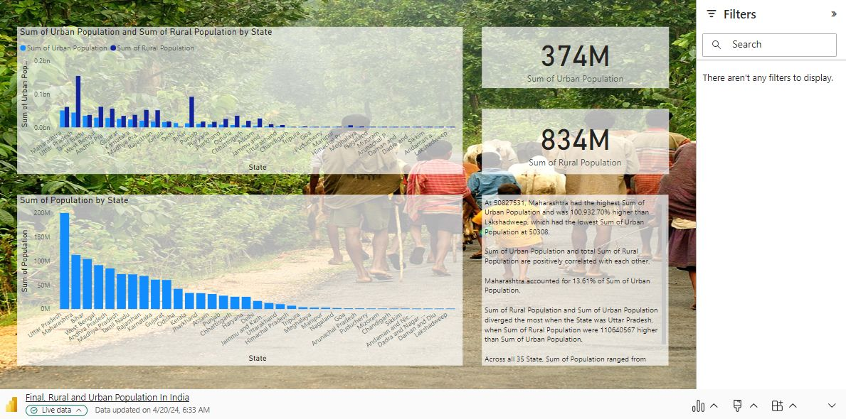
Microsoft Power BI

Slide 43
Work Management
Description: We have performed initial visualization utilizing D3.js and performing data cleaning and visualizing the data and utilizing the power Bi we are creating the dashboards
Responsibility And Contributions:
Each team member contributed to different stages of the project based on their expertise and availability.
24% - Sai Ram Amaraneni focused on data collection and initial visualization using D3.js.
26% - Praharsha Mutyala led the data cleaning process using Python and Pandas.
24% - Murali Manobhiram Penumutchu was responsible for refined visualization using Matplotlib and Seaborn.
26% - Satish Velaga took charge of dashboard creation in Microsoft Power BI and report generation.

Slide 44
References/Bibliography
Swamikannu, Nedumaran; Pingali, Parthasarathy Rao; Padmanabhan, Jyosthnaa; Ravula, Padmaja; Gumma, Murali Krishna; Mohammed, Irshad Ahmed; Rathore, Abhishek, 2021, "District Level Data (DLD) and Dashboard for Agriculture and Allied sectors in India", https://doi.org/10.21421/D2/XFB1BZ, ICRISAT Dataverse, V1
W. Fan, C. Chong, G. Xiaoling, Y. Hua, and W. Juyun, ‘‘Prediction of crop yield using big data,’’ in Proc. 8th Int. Symp. Comput. Intell. Design (ISCID), Dec. 2015, pp. 255–260, doi: 10.1109/ISCID.2015.191.
M. Kumar and M. Nagar, ‘‘Big data analytics in agriculture and distribution channel,’’ in Proc. Int. Conf. Comput. Methodol. Commun. (ICCMC), Jul. 2017, pp. 384–387.
Ilter, C. (2017). What economic and social factors affect GDP per capita? A study on 40 countries. Journal of Global Strategic Management, 11(2), 51-62. https://doi.org/10.20460/jgsm.2018.252
Matplotlib Documentation: https://matplotlib.org/stable/contents.html
Pandas Documentation: https://pandas.pydata.org/docs/

